Slide 1



Noida Institute of Engineering and Technology, Greater Noida
Customer Relationship Management (AOE0865)
Unit: 5
Unit 5: Emerging Dimensions of
CRM
Ms. Rachna Sharma
CSE(DS)Department
B Tech 8th Sem

Slide 2
Noida Institute of Engineering and Technology, Greater Noida
Introduction to Emerging CRM Dimensions
CRM is evolving with advancements in technology and changing customer expectations.
Focus on customer experience, AI, cloud computing, and real-time tools.
Goal:
Understand the emerging dimensions and their impact on business.

Slide 3
Noida Institute of Engineering and Technology, Greater Noida
Customer Experience Concepts
Definition:
Customer experience (CX) is the overall perception customers have of a company based on interactions.
Key Elements:
Personalization
Consistency across channels
Proactive support
Benefits:
Builds loyalty
Enhances brand reputation

Slide 4
Noida Institute of Engineering and Technology, Greater Noida
Managing Customer Experience
Strategies:
Use customer feedback to improve services
Map customer journeys
Leverage data analytics for insights
Tools:
CRM platforms with CX features (e.g., Salesforce, HubSpot)

Slide 5
Noida Institute of Engineering and Technology, Greater Noida
Social CRM
Definition:
Integrates social media platforms into CRM strategies.
Key Features:
Social listening
Engagement tracking
Sentiment analysis
Benefits:
Builds stronger customer relationships
Provides real-time feedback

Slide 6
Noida Institute of Engineering and Technology, Greater Noida
Strategic CRM
Definition: Focuses on managing customer relationships to achieve long-term business goals.
Key Elements:
Customer Portfolio Management (CPM)
CRM Tools and Strategies

Slide 7
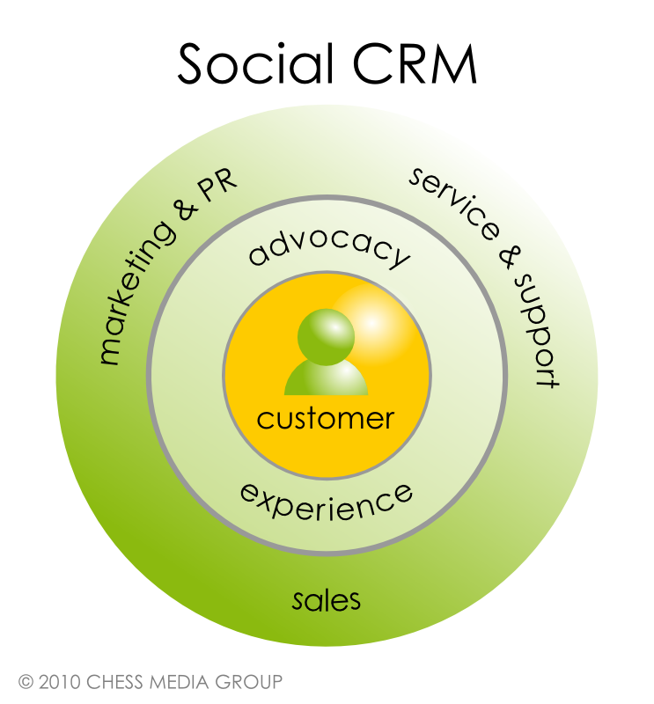
Noida Institute of Engineering and Technology, Greater Noida

Slide 8
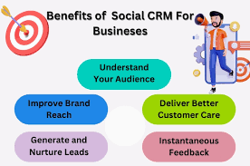
Noida Institute of Engineering and Technology, Greater Noida

Slide 9
Noida Institute of Engineering and Technology, Greater Noida
Artificial Intelligence and CRM
AI Applications in CRM:
Chatbots for customer support
Predictive analytics for sales and marketing
Personalization through machine learning
Examples:
AI-powered tools like Einstein (Salesforce AI), Dynamics 365 AI

Slide 10
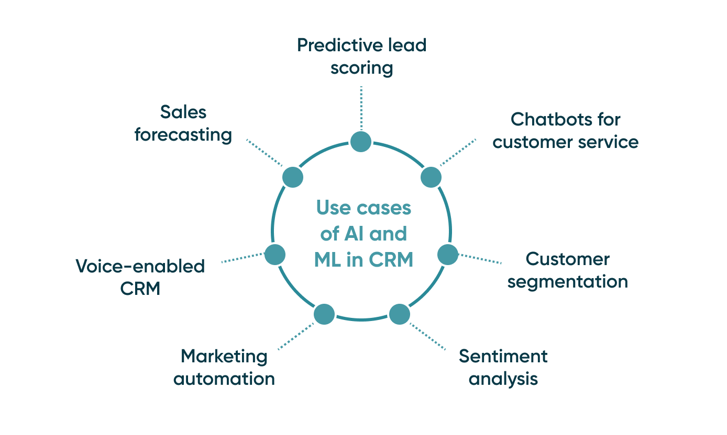
Noida Institute of Engineering and Technology, Greater Noida

Slide 11
Noida Institute of Engineering and Technology, Greater Noida
Cloud CRM and Big Data
Cloud CRM:
Definition: CRM hosted on cloud platforms
Features: Scalability, flexibility, remote access
Examples: Zoho CRM, Salesforce
Big Data in CRM:
Uses: Customer segmentation, personalized marketing
Tools: Hadoop, Spark, AWS

Slide 12
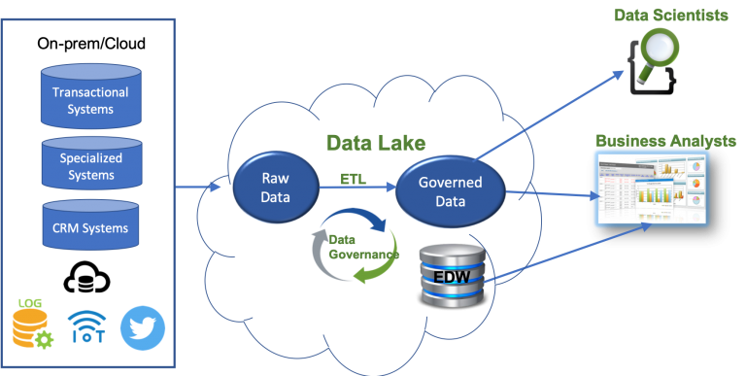
Noida Institute of Engineering and Technology, Greater Noida

Slide 13
Noida Institute of Engineering and Technology, Greater Noida
Emerging CRM Technologies
Key Technologies:
XaaS (Anything-as-a-Service)
PaaS (Platform-as-a-Service)
IaaS (Infrastructure-as-a-Service)
Advantages:
Reduces infrastructure costs
Enhances system integration

Slide 14
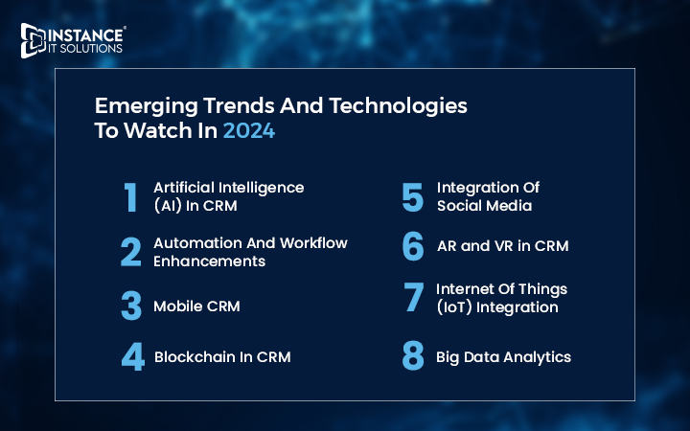
Noida Institute of Engineering and Technology, Greater Noida

Slide 15
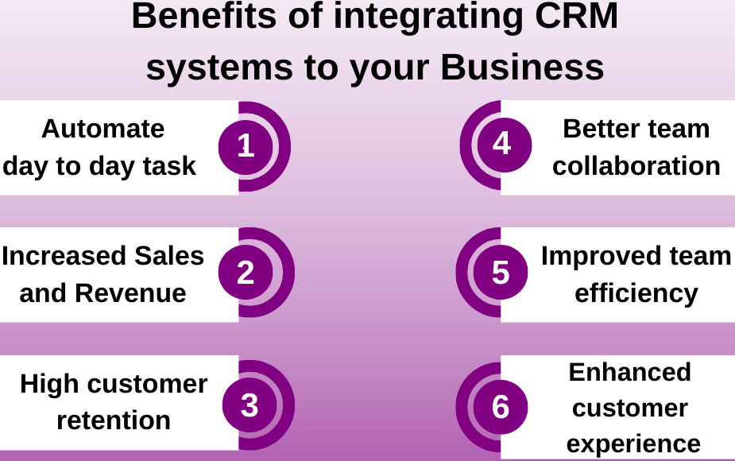
Noida Institute of Engineering and Technology, Greater Noida

Slide 16
Noida Institute of Engineering and Technology, Greater Noida
Emerging CRM Technologies
Key Technologies:
XaaS (Anything-as-a-Service)
PaaS (Platform-as-a-Service)
IaaS (Infrastructure-as-a-Service)
Advantages:
Reduces infrastructure costs
Enhances system integration

Slide 17
Noida Institute of Engineering and Technology, Greater Noida
Mobile CRM
Definition:
CRM accessible via mobile devices
Key Features:
On-the-go access to customer data
Real-time updates
Integration with mobile apps
Examples: Zoho Mobile CRM, HubSpot Mobile CRM

Slide 18
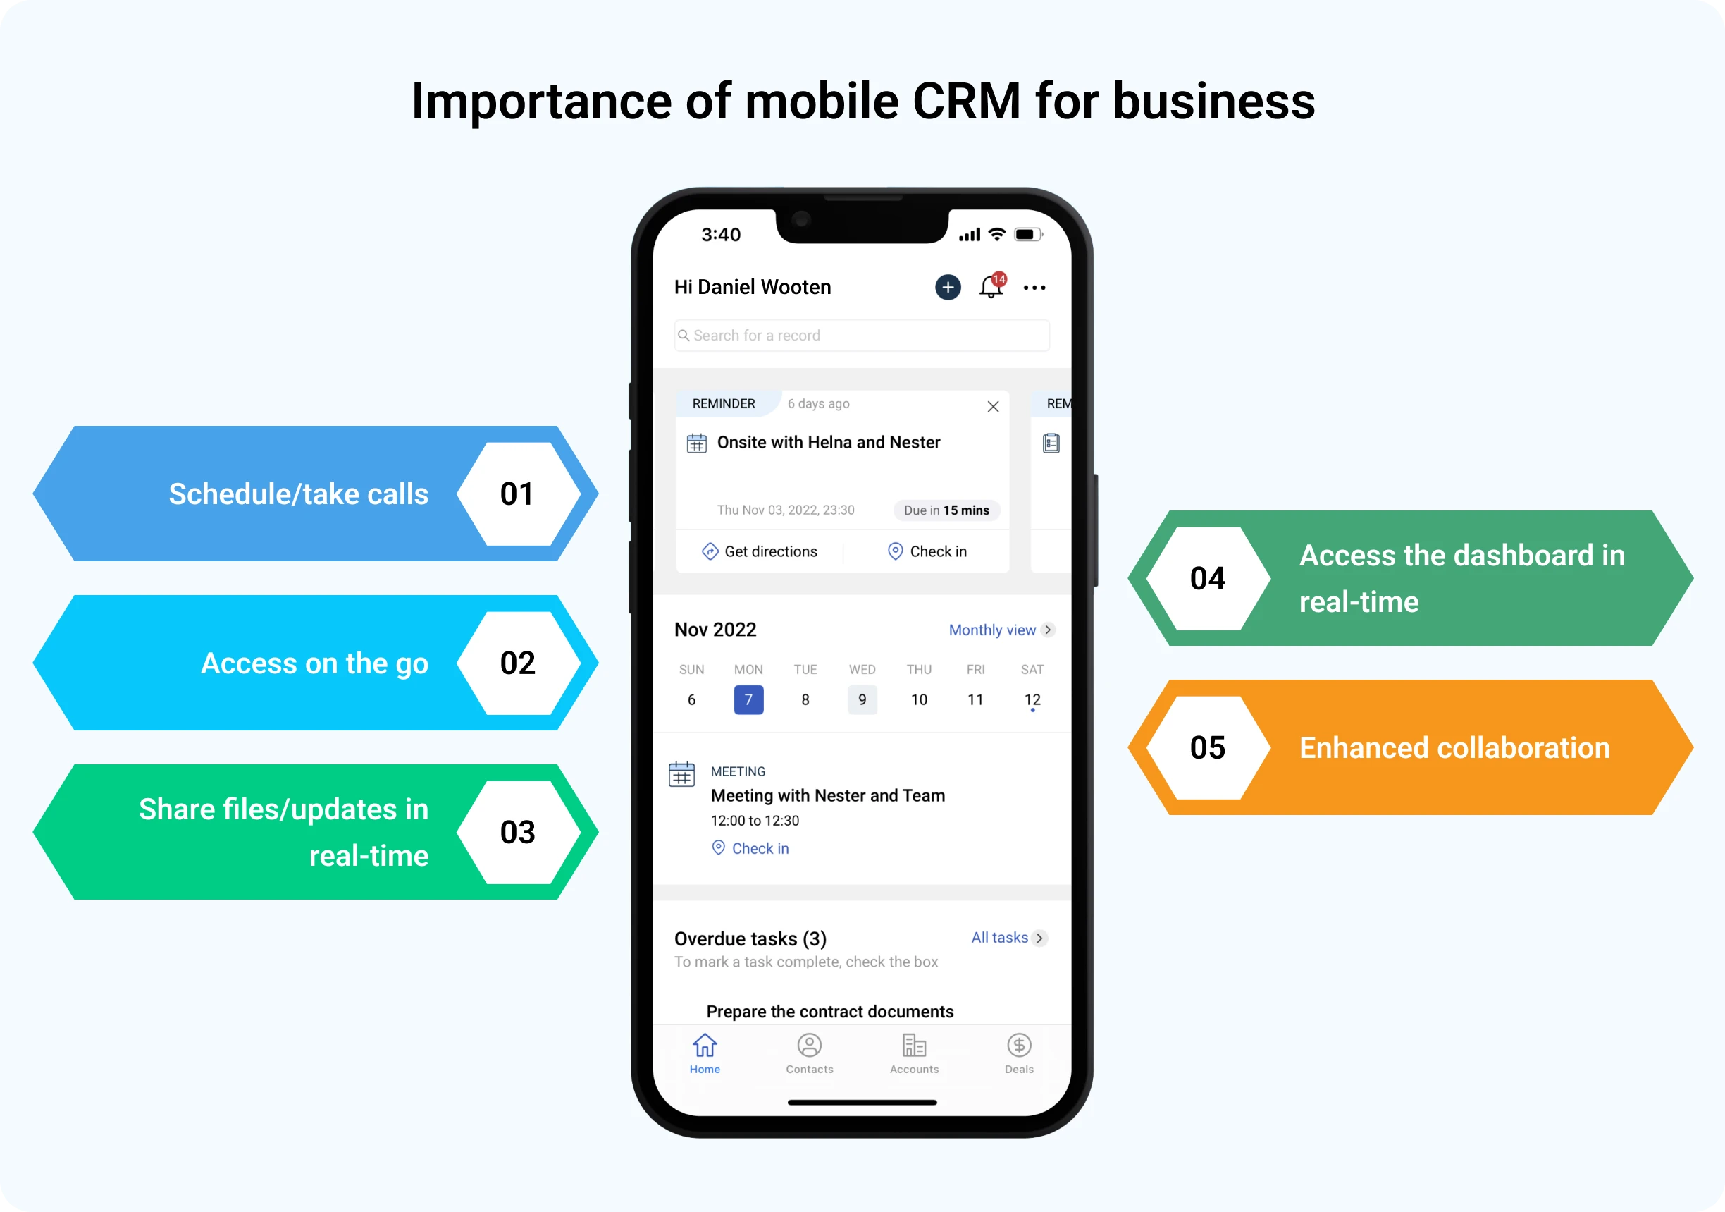
Noida Institute of Engineering and Technology, Greater Noida

Slide 19
Noida Institute of Engineering and Technology, Greater Noida
Real-Time CRM Tools
Examples:
Zoho CRM
Oracle NetSuite CRM
EBS CRM
Features:
Real-time analytics
Automated workflows
Integration with other systems
Benefits:
Faster decision-making
Improved customer responsiveness

Slide 20
Noida Institute of Engineering and Technology, Greater Noida
Challenges of CRM
Key Challenges:
Data security and privacy concerns
Integration with legacy systems
High implementation costs
Keeping up with rapid technology changes

Slide 21
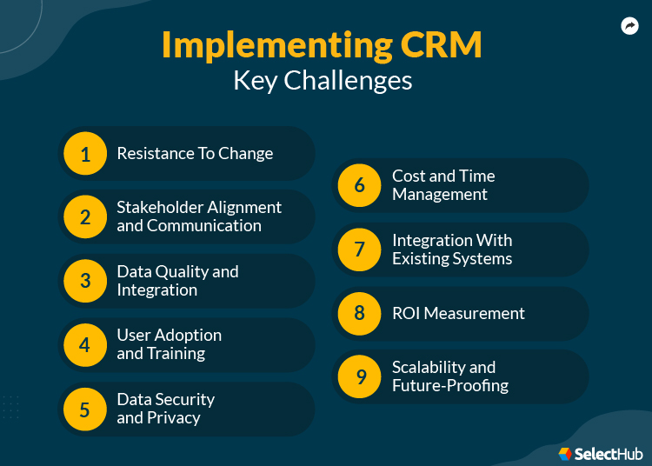
Noida Institute of Engineering and Technology, Greater Noida

Slide 22
Noida Institute of Engineering and Technology, Greater Noida
Opportunities of CRM
Emerging Opportunities:
Enhanced personalization with AI
Broader reach through social CRM
Cost reduction via cloud technologies
Improved decision-making with real-time tools

Slide 23
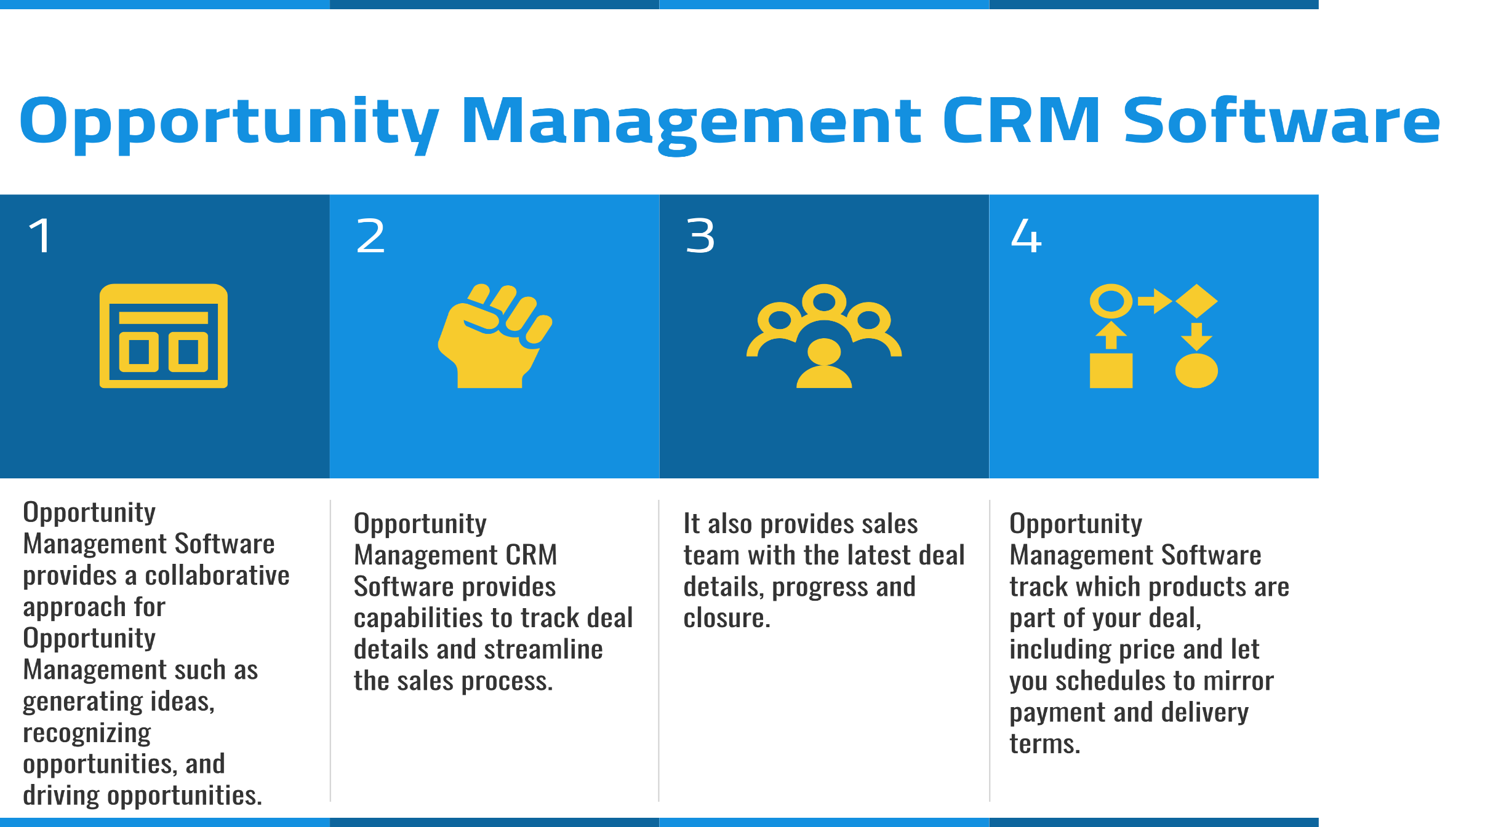
Noida Institute of Engineering and Technology, Greater Noida

Slide 24
Noida Institute of Engineering and Technology, Greater Noida
MCQs
1. What does CRM stand for?
A.Customer Relationship Management B. Client Retention Management C. Customer Resource Management D. Consumer Retention Methods
2. Which of the following is an example of a Real-Time CRM Tool?
A. Adobe Photoshop B. Zoho CRM C. Microsoft Word D. Canva
3. What is the primary focus of Social CRM?
A. Data Warehousing B. Financial Management C. Engaging with customers through social media platforms D. Manufacturing and supply chain management

Slide 25
Which technology is most commonly associated with Cloud CRM?
A. Hadoop B. SaaS (Software-as-a-Service) C. Blockchain D. AR (Augmented Reality)
Which of the following is NOT a feature of Artificial Intelligence in CRM?
A. Predictive Analytics B. Automating mundane tasks C. Static, unchangeable customer profiles D. Chatbots for customer support
6. Which of these is NOT an emerging CRM technology?
A. IaaS (Infrastructure-as-a-Service) B. PaaS (Platform-as-a-Service) C. ERP (Enterprise Resource Planning) D. XaaS (Anything-as-a-Service)

Slide 26
REFERENCES
Here are some highly recommended books on the subject of Customer Relationship Management:
"Customer Relationship Management: Concepts and Technologies" – by Francis Buttle & Stan Maklan
2. Customer Relationship Management: A Strategic Approach" – by G. Shainesh & Jagdish N. Sheth W. Stallings, Data and Computer Communication, Macmillan Press
3. The CRM Handbook: A Business Guide to Customer Relationship Management" – by Jill Dyché
4. Managing Customer Experience and Relationships: A Strategic Framework" – by Don Peppers & Martha Rogers Bhavneet Sidhu, An Integrated approach to Computer Networks, Khanna Publishing House
5. Coursera – "Customer Relationship Management" (by IE Business School)

Slide 27


Thank You

